Slide 1
Graph
Anagha durugkar

Slide 2
INTRODUCTION
A graph is an abstract data structure that is used to implement the graph concept from mathematics.
A graph is basically, a collection of vertices (also called nodes)
and edges that connect these vertices.

Slide 3
A graph is often viewed as a generalization of the tree structure,
where instead of a having a purely parent-to-child relationship between tree nodes,
any kind of complex relationships between the nodes can be represented.

Slide 4
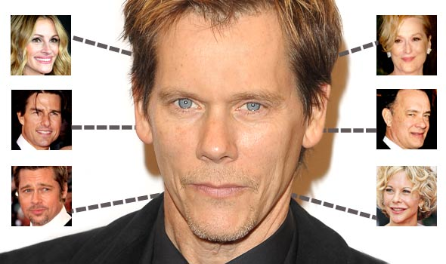
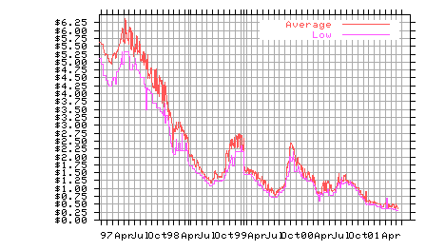
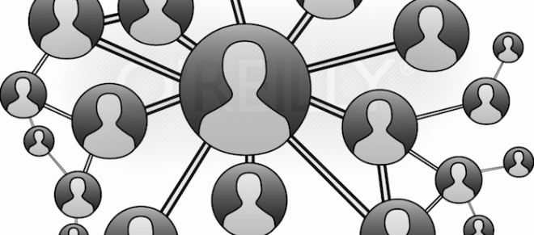
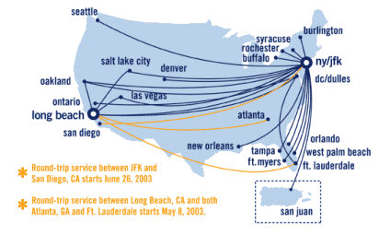
What is a graph?
56
Tokyo
Seattle
Seoul
128
16
181
New York
30
140
L.A.
Sydney

Slide 5
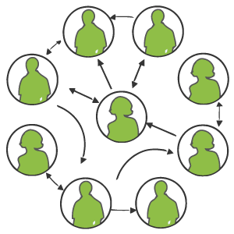
Graph examples
For each, what are the vertices and what are the edges?
  Web pages with links
  Methods in a program that call each other
  Road maps (e.g., Google maps)
  Airline routes
  Facebook friends
  Course pre-requisites
  Family trees
  Paths through a maze

Slide 6
Why graphs are useful?
Graphs are widely used to model any situation where entities or things are related to each other in pairs;
for example, the following information can be represented by graphs:
Family trees in which the member nodes have an edge from parent to each of their children.
Transportation networks in which nodes are airports, intersections, ports, etc.
The edges can be airline flights, one-way roads, shipping routes, etc.

Slide 7
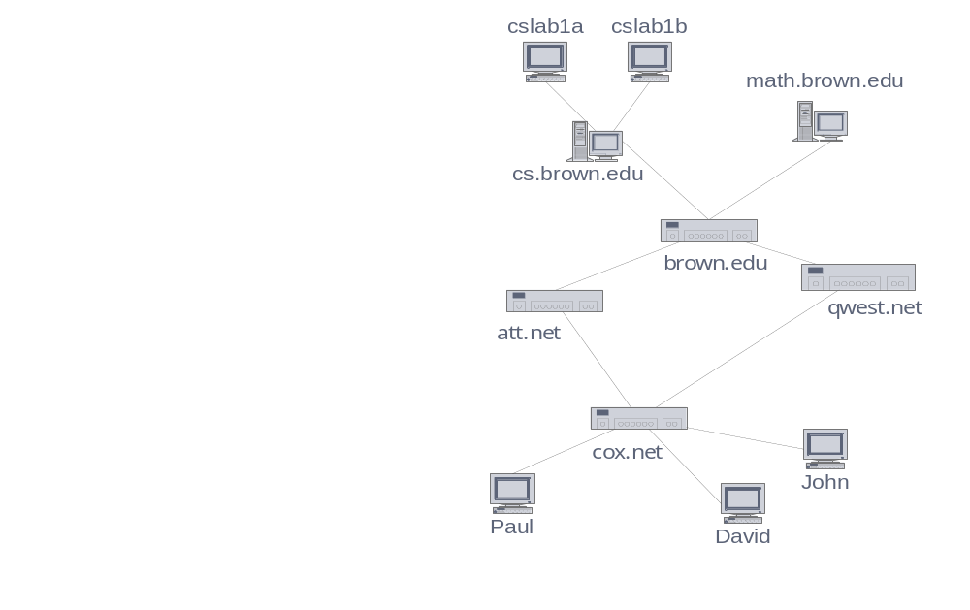
Applications
Electronic circuits
  Printed circuit board
  Integrated circuit
Transportation networks
  Highway network
  Flight network
Computer networks
  Local area network
  Internet
  Web
Databases
  Entity-relationship diagram
Graphs

Slide 8
Definition
A graph can be directed or undirected.
In an undirected graph, the edges do not have any direction associated with them.
That is, if an edge is drawn between nodes A and B,
then the nodes can be traversed from A to B as well as from B to A.
The above figure shows an undirected graph because it does not gives any information about the direction of the edges.

Slide 9
Edge Types
Directed edge (ARROW)
  ordered pair of vertices (u,v)
  first vertex u is the origin
  second vertex v is the destination
  e.g., a flight
Undirected edge (no arrow)
  unordered pair of vertices (u,v)
  e.g., a flight route
Directed graph
  all the edges are directed
  e.g., route network
Undirected graph
  all the edges are undirected
  e.g., flight network
flight
AA 1206
ORD
PVD
849
miles
ORD
PVD
A road between two points
Could be one way (directed)
Or two way (undirected)
Could have more than one edge
(e.g. toll road and public road)
Graphs

Slide 10
Definition
A graph G is defined as an ordered set (V, E),
where V(G) represent the set of vertices and
E(G) represents the edges that connect the vertices.
The figure given shows a graph with V(G) = { A, B, C, D and E}
and E(G) = { (A, B), (B, C), (A, D), (B, D), (D, E), (C, E) }.
Note that there are 5 vertices
or nodes and 6 edges in the graph.
A
B
C
E
D

Slide 11
Graph Terminology
Adjacent Nodes or Neighbors:
For every edge, e = (u, v) that connects nodes u and v;
the nodes u and v are the end-points
and are said to be the adjacent nodes or neighbors.

Slide 12
Degree of a node:
Degree of a node u, deg(u), is the total number of edges containing the node u.
If deg(u) = 0, it means that u does not belong to any edge
and such a node is known as an isolated node.

Slide 13
Regular graph:
Regular graph is a graph where each vertex has the same number of neighbors.
That is every node has the same degree
.
A regular graph with vertices of degree k is called a k‑regular graph or regular graph of degree k.

Slide 14
Terminology
End vertices (or endpoints) of an edge
  U and V are the endpoints of a
Edges incident on a vertex
  a, d, and b are incident on V
Adjacent vertices
  U and V are adjacent
Degree of a vertex
  X has degree 5
Parallel edges
  h and i are parallel edges
Self-loop
  j is a self-loop
V
a
b
h
j
U
d
X
Z
c
e
i
W
g
f
Y
Graphs

Slide 15
Path
Path: A path P, written as P = {v0, v1, v2,….., vn), of length n from a node u to v is defined as a sequence of (n+1) nodes.
Here, u = v0, v = vn and vi-1 is adjacent to vi for i = 1, 2, 3, …, n.
A path from vertex vp to vertex vq in a graph G,
is a sequence of vertices, vp, vi1, vi2, ..., vin, vq,
such that (vp, vi1), (vi1, vi2), ..., (vin, vq) are edges
in an undirected graph
The length of a path is the number of edges on it

Slide 16
Simple path: A path P is known as a simple path if all the nodes in the path are distinct with an exception that v0 may be equal to vn. If v0 = vn, then the path is called a closed simple path

Slide 17
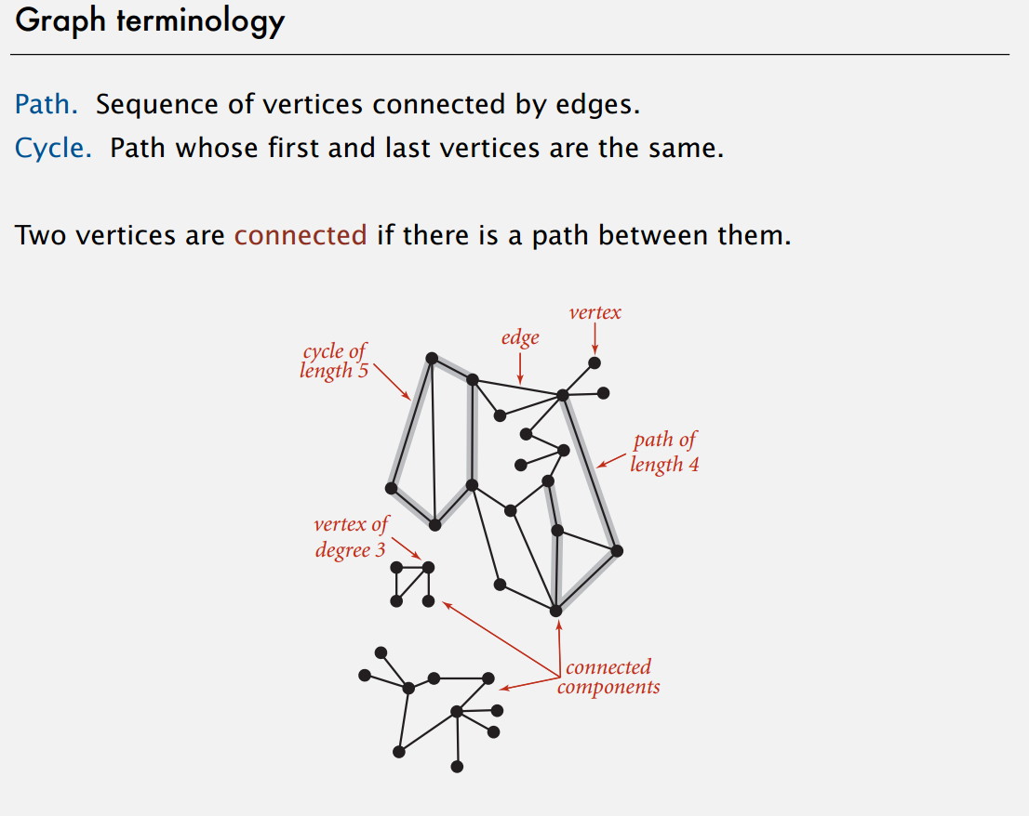

Slide 18
Subgraph
A subgraph of G is a graph G’ such that V(G’)
is a subset of V(G) and E(G’) is a subset of E(G)
CHAPTER 6

Slide 19
Figure 6.4: subgraphs of G₁ and G₃ (p.261)
0
0
0
1
2
0
1
2
1
2
3
1
2
3
3
G1
(i) (ii) (iii) (iv)
(a) Some of the subgraph of G₁
0
0
0
0
0
單一
1
1
1
1
分開
2
2
(i) (ii) (iii) (iv)
(b) Some of the subgraph of G₃
2
G3
CHAPTER 6

Slide 20
Connected graph:
A graph in which there exists a path between any two of its nodes is called a connected graph.
That is to say that there are no isolated nodes in a connected graph.
A connected graph that does not have any cycle is called a tree.

Slide 21
A tree is a graph that is connected and acyclic

Slide 22
connected
0
0
1
2
1
2
3
3
4
5
6
G1
G2
tree (acyclic graph)
CHAPTER 6

Slide 23
Complete graph:
A graph G is said to be a complete,
if all its nodes are fully connected,
that is, there is a path from one node to every other node in the graph.
A complete graph has n(n-1)/2 edges,
where n is the number of nodes in G.

Slide 24
Labeled graph or weighted graph:
A graph is said to be labeled if every edge in the graph is assigned some data.
In a weighted graph, the edges of the graph are assigned some weight or length.
Weight of the edge, denoted by w(e) is a positive value which indicates the cost of traversing the edge.

Slide 25
Multiple edges:
Distinct edges which connect the same end points are called multiple edges.
That is, e = {u, v) and e’ = (u, v) are known as multiple edges of G.

Slide 26
Size of the graph:
The size of a graph is the total number of edges in it

Slide 27
Directed Graph
A directed graph G, also known as a digraph,
is a graph in which every edge has a direction assigned to it.
An edge of a directed graph is given as an ordered pair (u, v) of nodes in G.
For an edge (u, v)-
the edge begins at u and terminates at v
u is known as the origin or initial point of e.
Correspondingly, v is known as the destination or terminal point of e
u is the predecessor of v. Correspondingly, v is the successor of u
nodes u and v are adjacent to each other.

Slide 28
Directed Graph
Terminology of a directed graph
Out-degree of a node:
The out degree of a node u, written as outdeg(u), is the number of edges that originate at u.
In-degree of a node:
The in degree of a node u, written as indeg(u), is the number of edges that terminate at u.
Degree of a node:
Degree of a node written as deg(u) is equal to the sum of in-degree and out-degree of that node. Therefore, deg(u) = indeg(u) + outdeg(u)

Slide 29
Source:
A node u is known as a source if it has a positive out-degree but an in-degree = 0.
Sink:
A node u is known as a sink if it has a positive in degree but a zero out-degree.

Slide 30
Reachability:
A node v is said to be reachable from node u,
if and only if there exists a (directed) path from node u to node v.
Strongly connected directed graph:
A digraph is said to be strongly connected if and only
if there exists a path from every pair of nodes in G.
That is, if there is a path from node u to v, then there must be a path from node v to u.

Slide 31
Unilaterally connected graph:
A digraph is said to be unilaterally connected
if there exists a path from any pair of nodes u, v in G
such that there is a path from u to v or a path from v to u but not both.

Slide 32
Parallel/Multiple edges:
Distinct edges which connect the same end points are called multiple edges.
That is, e = {u, v) and e’ = (u, v) are known as multiple edges of G.
Simple directed graph:
A directed graph G is said to be a simple directed graph if and only if it has no parallel edges.
However, a simple directed graph may contain cycle with an exception that it cannot have more than one loop at a given node

Slide 33
(a): Directed Acyclic Graph | (b): Strongly Connected Directed Acyclic Graph
A
B
e8
A
B
e2
e7
e4
e6
C
e3
D
C
D
e5
A
B
C
D
E
A
B
C
D
E
Graph G
Transitive Closure G*

Slide 34
BI-CONNECTED GRAPHS
A vertex v of G is called an articulation point if removing v along with the edges incident to v, results in a graph that has at least two connected components.
A bi-connected graph is defined as a connected graph that has no articulation vertices.
That is, a bi-connected graph is connected and non-separable,
in the sense that even if we remove any vertex from the graph, the resultant graph is still connected. By definition,

Slide 35
A bi-connected undirected graph is a connected graph that is not broken into disconnected pieces by deleting any single vertex
In a bi-connected directed graph for any two vertices v and w there are two directed paths from v to w which have no vertices in common other than v and w.

Slide 36
BI-CONNECTED GRAPHS
Note that the graph shown on the left is not a bi-connected graph as deleting vertex C from the graphs results in two connected components of the original graph (figure on right)
A
H
B
C
I
A
H
B
I
D
J
D
J
E
F
E
F

Slide 37
A
B
Bi-connected graph. Removal of any vertex from the graph will not disconnect the graph
D
C
A
B
C
D
E
Like graphs, there is a related concept for edges. An edge in a graph is called a bridge, if removing that edge results in a disconnected graph. Also, an edge on the graph that does not lie on a cycle is a bridge. This means that a bridge has at least one articulation point at its end, although it is not necessary that the articulation point is linked in a bridge.

Slide 38
REPRESENTATION OF GRAPHS
There are two common ways of storing graphs in computer’s memory. They are:
Sequential representation by using an adjacency matrix
Linked representation by using an adjacency list that stores the neighbors of a node using a linked list

Slide 39
Adjacency Matrix Representation
An adjacency matrix is used to represent which nodes are adjacent to one another.
By definition, we have learnt that, two nodes are said to be adjacent if there is an edge connecting them.
In a directed graph G, if node v is adjacent to node u, then surely there is an edge from u to v.
That is, if v is adjacent to u, we can get from u to v by traversing one edge.
For any graph G having n nodes, the adjacency matrix will have dimensions of n X n.

Slide 40
In an adjacency matrix,
the rows and columns are labeled by graph vertices.
An entry aij in the adjacency matrix will contain 1, if vertices vi and vj are adjacent to each other.
However, if the nodes are not adjacent, aij will be set to zero.

Slide 41
Adjacency Matrix Representation
1 if v_{i} is adjacent to v_{j}, that is there is an edge (v_{i}, v_{j})
aij
0 otherwise
Since an adjacency matrix contains only 0s and 1s, it is called a bit matrix or a Boolean matrix.
The entries in the matrix depend on the ordering of the nodes in G.
therefore, a change in the order of nodes will result in a different adjacency matrix.

Slide 42
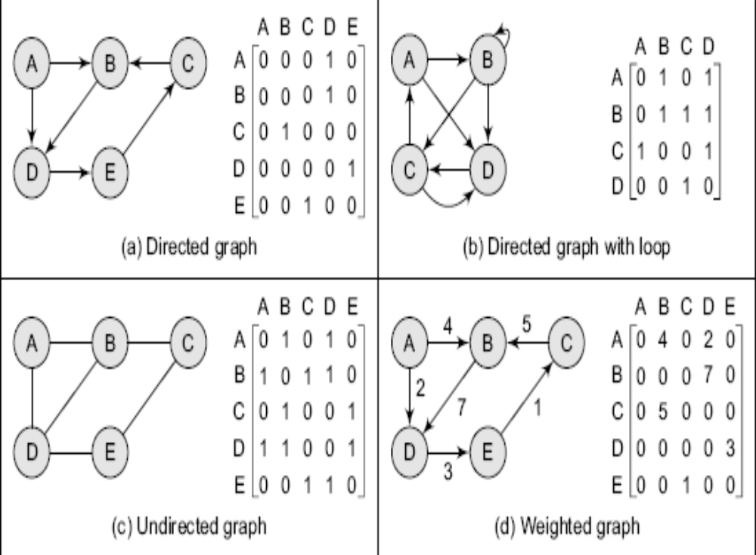

Slide 43
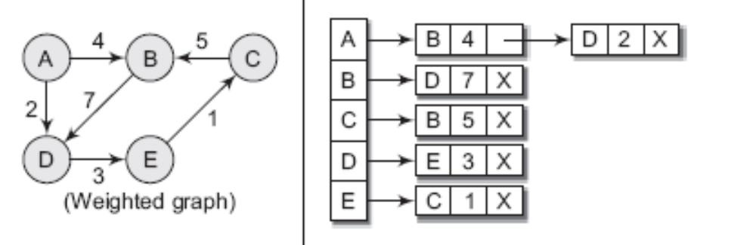
From adjacency matrix A1, we have learnt that an entry 1 in the ith row and jth column means that there exists a path of length 1 from vi to vj. Now consider, A2, A3 and A4
a_{ij} ² = ∑ a_{ik} a_{kj}
Any entry a_{ij} = 1 if a_{ik} = a_{kj} = 1. That is, if there is an edge (v_{i}, v_{k}) and (v_{k}, v_{j}). This implies that there is a path from vi to vj of length 2.
Similarly, every entry in the ith row and jth column of A3 gives the number of paths of length 3 from node vi to vj.
In general terms, we can conclude that every entry in the ith row and jth column of An (where n is the number of nodes in the graph) gives the number of paths of length n from node vi to vj.

Slide 44
Adjacency List
The adjacency list is another way in which graphs can be represented in computer’s memory.
this structure consists of a list of all nodes in G.
Furthermore, every node is in turn linked to its
“own list that contains the names of all other nodes that are adjacent to itself.”

Slide 45
The key advantage of using an adjacency list includes:
It is easy to follow, and clearly shows the adjacent nodes of a particular node
It is often used for storing graphs that have a small to moderate number of edges.
That is an Adjacency list is preferred for representing sparse graphs in computer’s memory; otherwise, an adjacency matrix is a good choice.
Adding new nodes in G is easy and straightforward when G is represented using an Adjacency list.
Adding new nodes in an Adjacency matrix is a difficult task as size of the matrix needs to be changed and existing nodes may have to be reordered.

Slide 46
A
B
A
B
C
D
B
C X
B
C X
C
D
D X
B X
Graph G and its adjacency list
For a directed graph, the sum of lengths of all adjacency lists is equal to the number of edges in G. However, for an undirected graph, the sum of lengths of all adjacency lists is equal to twice the number of edges in G because an edge (u, v) means an edge from node u to v as well as an edge v to u. The adjacency list can also be modified to store weighted graphs.
A
B
C
D
E
A
B
C
B
D X
A
C
D X
D
E
B
E X
A
B
E X
C
D X

Slide 47
GRAPH TRAVERSAL ALGORITHMS
By traversing a graph, we mean the method of examining the nodes and edges of the graph. There are two standard methods of graph traversal which we will discuss in this section.
These two methods are-
Breadth first search
Depth first search
While breadth first search will use a queue as an auxiliary data structure to store nodes for further processing,
the depth-first search scheme will use a stack.

Slide 48
But both these algorithms will make use of a variable STATUS.
During the execution of the algorithm,
every node in the graph will have the variable STATUS
set to 1, 2 or depending on its current state.
Table I shows the value of status and its significance.
STATUS | STATE OF THE NODE | DESCRIPTION
1 | Ready | The initial state of the node N
2 | Waiting | Node N is placed on the queue or stack and waiting to be processed
3 | Processed | Node N has been completely processed

Slide 49
Breadth First Search
Breadth-first search (BFS) is a graph search algorithm that begins at the root node and explores all the neighboring nodes. Then for each of those nearest nodes, the algorithm explores their unexplored neighbor nodes, and so on, until it finds the goal.
That is, we start examining the node A and then all the neighbors of A are examined. In the next step we examine the neighbors of neighbors of A, so on and so forth
Example: Consider the graph G given below. The adjacency list of G is also given. Assume that G represents the daily flights between different cities and we want to fly from city A to H with minimum stops. That is, find the minimum path P from A to H given that every edge has length = 1.

Slide 50
Breadth First Search
Breadth-first search (BFS) is a graph search algorithm that begins at the root node and explores all the neighboring nodes. Then for each of those nearest nodes, the algorithm explores their unexplored neighbor nodes, and so on, until it finds the goal.
That is, we start examining the node A and then all the neighbors of A are examined. In the next step we examine the neighbors of neighbors of A, so on and so forth
Example: Consider the graph G given below. The adjacency list of G is also given. Assume that G represents the daily flights between different cities and we want to fly from city A to H with minimum stops. That is, find the minimum path P from A to H given that every edge has length = 1.

Slide 51
Breadth First Search
Breadth-first search (BFS) is a graph search algorithm that begins at the root node and explores all the neighboring nodes.
Then for each of those nearest nodes, the algorithm explores their unexplored neighbor nodes, and so on, until it finds the goal.
That is, we start examining the node A and then all the neighbors of A are examined.
In the next step we examine the neighbors of neighbors of A, so on and so forth

Slide 52
Breadth First Search
1.In BFS we start at vertices v and marked it is having been reached.
All unvisited vertices adjustant from node v are visited next.
These are new unexplored vertices.
2.then vertex v now has been explored .
The new vertices that have not been visited are put onto the end of the list of unexplored vertices.
3.the vertex first in list are next to be explored.
This continues until no unexplored vertex is left.

Slide 53
The list of unexplored vertices as a queue can be represented as QUEUE.
It is based on FIFO system.

Slide 54
Algorithm BFS
1.h=g;
2.visited[g]=1;
3.repeat {
4. for all vertices w adjustant from h do
{
If (visited[w]=0) then
{
Add w to q // w is unexlored
visited[w]=1;
} //end of if
}end of for loop

Slide 55
5.if q is empty then return
Pop h from q
} until (false)
// end of repeat.
6.end of BFS

Slide 56
1
2
3
4
5
6
7
8
9

Slide 57
1.start at node 1.
Front =1 rear =1
Queue=1
2 delete 1 from q add adj node of 1 to q which is not visited.
Front =2 rear =5
Queue=2 3 4 5

Slide 58
3 delete 2 from q add adj node of 2 to q which is not visited.
Front =3 rear =6
Queue= 3 4 5 6
4. delete 3 from q add adj node of 3 to q which is not visited.
Front =4 rear =7
Queue= 4 5 6 7

Slide 59
5 delete 4 from q add adj node of 4 to q which is not visited.
Front =5 rear =8
Queue= 5 6 7 8
6. delete 5 from q add adj node of 5 to q which is not visited.
Front =6 rear =8
Queue= 6 7 8

Slide 60
7 delete 6 from q add adj node of 6 to q which is not visited.
Front =7 rear =9
Queue= 7 8 9
8. delete 7 from q add adj node of 7 to q which is not visited.
Front =8 rear =9
Queue= 8 9

Slide 61
9 delete 8 from q add adj node of 8 to q which is not visited.
Front =9 rear =9
Queue= 9
10. delete 9 from q add adj node of 9 to q which is not visited.
Front =0 rear =0
Queue= 0 (empty)

Slide 62
Bfs = 1 2 3 4 5 6 7 8 9.

Slide 64
Algorithm for breadth-first search in a graph G beginning at a starting node A
Step 1: SET STATUS = 1 (ready state) for each node in G.
Step 2: Enqueue the starting node A and set its STATUS = 2 (waiting state)
Step 3: Repeat Steps 4 and 5 until QUEUE is empty
Step 4:Dequeue a node N. Process it and set its STATUS = 3 (processed state).
Step 5:Enqueue all the neighbors of N that are in the ready state (whose STATUS = 1) and set their STATUS = 2 (waiting state)
[END OF LOOP]
Step 6: EXIT

Slide 65
Example: Consider the graph G given below.
The adjacency list of G is also given.
Assume that G represents the daily flights between different cities and we want to fly from city A to H with minimum stops.
That is, find the minimum path P from A to H given that every edge has length = 1.

Slide 66
A
Adjacency Lists
A: B, C, D B: E C: B, G D: C, G E: C, F F: C, H G: F, H, I H: E, I I: F
B
C
D
E
F
G
H
I
Initially add A to QUEUE and add NULL to ORIG, so
FRONT = 1 | QUEUE = A
REAR = 1 | ORIG = \0
Dequeue a node by setting FRONT = FRONT + 1 (remove the FRONT element of QUEUE) and enqueue the neighbors of A. Also add A as the ORIG of its neighbors, so
FRONT = 2 QUEUE = A B C D
REAR = 4 ORIG = \0 A A A
Dequeue a node by setting FRONT = FRONT + 1 and enqueue the neighbors of B. Also add B as the ORIG of its neighbors, so
FRONT = 3 QUEUE = A B C D E
REAR = 5 ORIG = \0 A A A B
Dequeue a node by setting FRONT = FRONT + 1 and enqueue the neighbors of C. Also add C as the ORIG of its neighbors. Note that C has two neighbors B and G. Since B has already been added to the queue and it is not in the Ready state, we will not add B and add only G, so
FRONT = 4 QUEUE = A B C D E G
REAR = 6 ORIG = \0 A A A B C

Slide 67
Dequeue a node by setting FRONT = FRONT + 1 and enqueue the neighbors of D. Also add D as the ORIG of its neighbors. Note that D has two neighbors C and G. Since both of them have already been added to the queue and they are not in the Ready state, we will not add them again, so
FRONT = 5 QUEUE = A B C D E G
REAR = 6 ORIG = \0 A A A B C
Dequeue a node by setting FRONT = FRONT + 1 and enqueue the neighbors of E. Also add E as the ORIG of its neighbors. Note that E has two neighbors C and F. Since C has already been added to the queue and it is not in the Ready state, we will not add C and add only F, so
FRONT = 6 QUEUE = A B C D E G F
REAR = 7 ORIG = \0 A A A B C G
Dequeue a node by setting FRONT = FRONT + 1 and enqueue the neighbors of G. Also add G as the ORIG of its neighbors. Note that G has three neighbors F, H and I.
FRONT = 7 QUEUE = A B C D E G F H I
REAR = 10 ORIG = \0 A A A B C G G G
Since I is our final destination, we stop the execution of this algorithm as soon as it is encountered and added to the QUEUE. Now backtrack from I using ORIG to find the minimum path P. thus, we have P as
A -> C -> G -> I.
DEPTH FIRST SERACH ALGORITHM
The Depth First Search algorithm progresses by expanding the starting node of G and thus going deeper and deeper until a goal node is found, or until a node that has no children is encountered. When a dead- end is reached, the algorithm backtracks, returning to the most recent node that has not been completely explored.
In other words, the Depth- First Search algorithm begins at a starting node A which becomes the current node. Then it examines each node N along a path P which begins at A. That is, we process a neighbor of A, then a neighbor of neighbor of A and so on. During the execution of the algorithm, if we reach a path that has a node N that has already been processed, then we backtrack to the current node. Otherwise, the un-visited (un-processed node) becomes the current node.

Slide 68
DEPTH FIRST SERACH ALGORITHM
The Depth First Search algorithm progresses by expanding the starting node of G and thus going deeper and deeper until a goal node is found, or until a node that has no children is encountered.
When a dead- end is reached, the algorithm backtracks, returning to the most recent node that has not been completely explored.

Slide 69
In other words, the Depth- First Search algorithm begins at a starting node A which becomes the current node.
Then it examines each node N along a path P which begins at A.
That is, we process a neighbor of A, then a neighbor of neighbor of A and so on.
During the execution of the algorithm, if we reach a path that has a node N that has already been processed, then we backtrack to the current node. Otherwise, the un-visited (un-processed node) becomes the current node.

Slide 70
1.exploration of vertex k is suspended as soon as new vertex is reached.
2.at this time exploration of new vertex is begin and its exploration is also supended as soon as new vertex is reached .
3.the search terminate when all reached vertices are fully explored.

Slide 71
The list of un explored veritces as a stack can be represented as stack.
It is based on LIFO system.

Slide 72
Algorithm DFS .
A depth first search is carried out begining at vertices g for any node i.
visited[i]=0; if i is already visited.
Initially no vertex is visited so for all nodes visited [i]=0

Slide 73
Algorithm DFS
1.h=g;
2.visited[g]=1;
3.repeat {
4. for all vertices w adjustant from h do
{
If (visited[w]=0) then
{
Push w to s // w is unexlored
visited[w]=1;
} //end of if
}end of for loop

Slide 74
5.if s is empty then return
Pop h from s
} until (false)
// end of repeat.
6.end of DFS

Slide 75
1
2
3
4
5
6
7
8
9

Slide 76
.start at node 1.
1.push 1 onto stack
stack =1
2 pop top from stack and push onto stack all adjacent nodes of 1 which is not visited.
stack=2 3 4 5

Slide 77
3. pop 5 from stack and push onto stack all adjacent nodes of 5 which is not visited.
stack=2 3 4
4. pop 4 from stack and push onto stack all adjacent nodes of 4 which is not visited.
Stack=2 3 7 8

Slide 78
5. pop 8 from stack and push onto stack all adjacent nodes of 8 which is not visited.
stack=2 3 7
6. pop 7 from stack and push onto stack all adjacent nodes of 7 which is not visited.
Stack=2 3 6

Slide 79
7. pop 6 from stack and push onto stack all adjacent nodes of 6 which is not visited.
stack=2 3 9
8. pop 9 from stack and push onto stack all adjacent nodes of 9 which is not visited.
Stack=2 3

Slide 80
9. pop 3 from stack and push onto stack all adjacent nodes of 6 which is not visited.
stack=2
10. pop 2 from stack and push onto stack all adjacent nodes of 2 which is not visited.
Stack= empty
DFS=1 5 4 8 7 6 9 3 2

Slide 81
DFS may depend upon the order in which direction we go in depth ,it may be different also.
Here we assumed the order of the node as inserted in adjacency list of graph.
The last node of the list represent the top of stack ,so in stack top elememt is explored subsequently.

Slide 83
Algorithm for depth-first search in a graph G beginning at a starting node A
Step 1: SET STATUS = 1 (ready state) for each node in G.
Step 2: Push the starting node A on the stack and set its STATUS = 2 (waiting state)
Step 3: Repeat Steps 4 and 5 until STACK is empty
Step 4: Pop the top node N. Process it and set its STATUS = 3 (processed state).
Step 5: Push on to the stack all the neighbors of N that are in the ready state (whose STATUS = 1) and set their STATUS = 2 (waiting state)
[END OF LOOP]
Step 6: EXIT
Example: Consider the graph G given below. The adjacency list of G is also given. Suppose we want to print all nodes that can be reached from the node H (including H itself). One alternative is to use a Depth- First Search of G starting at node H. the procedure can be explained as below.
A
Adjacency Lists
A: B, C, D B: E C: B, G D: C, G E: C, F F: C, H G: F, H, I H: E, I I: F
B
C
D
E
F
G
H
I

Slide 84
Push H on to the stack
STACK: H
Pop and Print the top element of the STACK, that is, H. Push all the neighbors of H on to the stack that are in the ready state. The STACK now becomes:
STACK: E, I
Pop and Print the top element of the STACK, that is, I. Push all the neighbors of I on to the stack that are in the ready state. The STACK now becomes:
STACK: E, F
PRINT: I
Pop and Print the top element of the STACK, that is, F. Push all the neighbors of F on to the stack that are in the ready state. (Note F has two neighbors C and H. but only C will be added as H is not in the ready state). The STACK now becomes:
PRINT: F
STACK: E, C
Pop and Print the top element of the STACK, that is, C. Push all the neighbors of C on to the stack that are in the ready state. The STACK now becomes:
STACK: E, B, G
PRINT: C
Pop and Print the top element of the STACK, that is, G. Push all the neighbors of G on to the stack that are in the ready state. Since there are no neighbors of G that are in the ready state no push operation is performed. The STACK now becomes:
PRINT G:
STACK: E, B
Pop and Print the top element of the STACK, that is, B. Push all the neighbors of B on to the stack that are in the ready state. Since there are no neighbors of B that are in the ready state no Push operation is performed. The STACK now becomes:
PRINT e:
STACK: E

Slide 85
Pop and Print the top element of the STACK, that is, E. Push all the neighbors of E on to the stack that are in the ready state. Since there are no neighbors of E that are in the ready state no Push operation is performed. The STACK now becomes empty:
PRINT: E
Since the STACK is now empty, the depth-first search of G starting at node H is complete and the nodes which were printed are-
H, I, F, C, G, B E.
These are the nodes which are reachable from the node H.

Slide 86
The End

Slide 87
TRANSITIVE CLOSURE OF A DIRECTED GRAPH
A transitive closure of a graph is constructed to answer reachability questions.
That is, is there a path from a node A to node E in one or more hops?
A binary relation indicates only whether the node A is connected to node B, and that node B is connected to node C, etc.
But once the transitive closure is constructed as shown below, we can easily determine that whether node E is reachable from node A or not.
Like the adjacency list, transitive closure is also stored as a matrix T, so if T[1][5] = 1, then it is the case that node 1 can reach node 5 in one or more hops

Slide 89
A
B
e8
A
B
e2
e7
e4
e6
C
e3
D
C
D
e5
TRANSITIVE CLOSURE OF A DIRECTED GRAPH
A transitive closure of a graph is constructed to answer reachability questions. That is, is there a path from a node A to node E in one or more hops? A binary relation indicates only whether the node A is connected to node B, and that node B is connected to node C, etc. But once the transitive closure is constructed as shown below, we can easily determine in O(1) time that whether node E is reachable from node A or not. Like the adjacency list, transitive closure is also stored as a matrix T, so if T[1][5] = 1, then it is the case that node 1 can reach node 5 in one or more hops.
A
B
C
D
E
A
B
C
D
E
Graph G
Transitive Closure G*

